Slide 1
Sisteme Tolerante la Defecte Consens în Sisteme Distribuite 2
Lect. Dr. Ing. Cristian Chilipirea – cristian.chilipirea@mta.ro

Slide 3
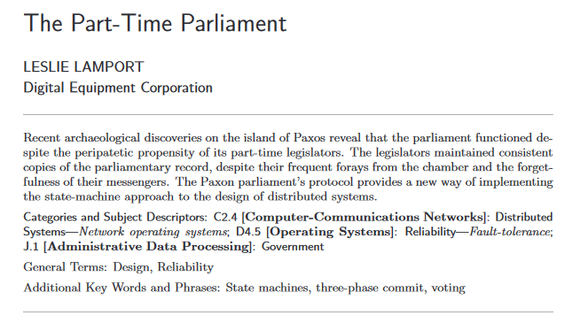

Consens rezistent la Faults - Paxos

Slide 4
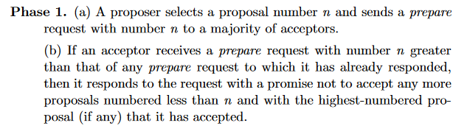
Paxos

Slide 5
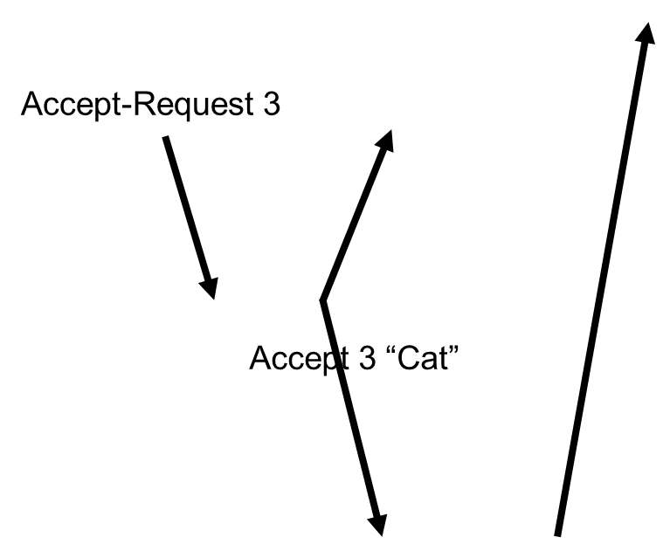
Paxos
Client
Prepare 3
Proposer
Acceptors
Promise 3
Learners
Notes:
https://en.wikipedia.org/wiki/Paxos_(computer_science)#cite_note-agree-1

Slide 6
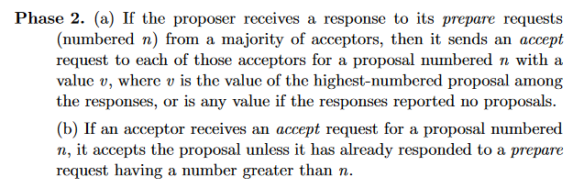
Paxos

Slide 7
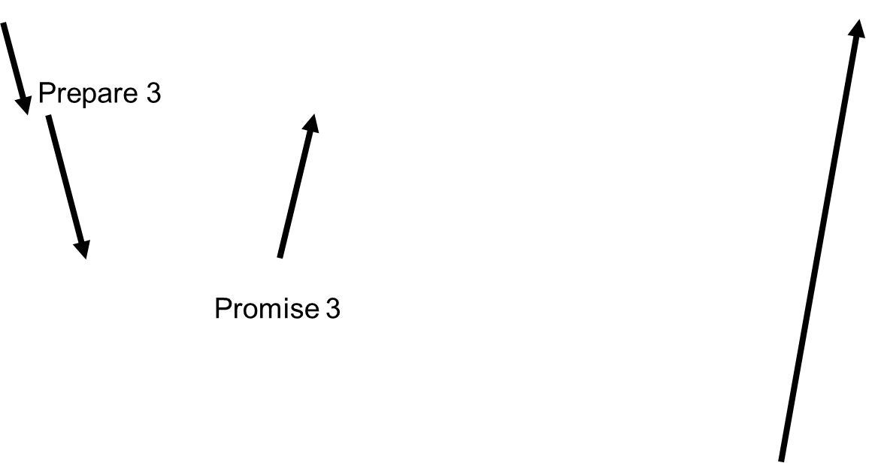
Paxos
Client
Accept-Request 3
Proposer
Acceptors
Accept 3 “Cat”
Learners
Notes:
https://en.wikipedia.org/wiki/Paxos_(computer_science)#cite_note-agree-1

Slide 8
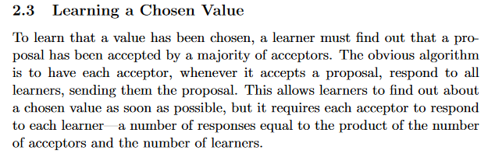
Paxos

Slide 9
Paxos
Client
Prepare 3
Accept-Request 3
Proposer
Acceptors
Promise 3
Accept 3 “Cat”
Learners
Notes:
https://en.wikipedia.org/wiki/Paxos_(computer_science)#cite_note-agree-1

Slide 10
Paxos
Client
Accept-Request 3
Prepare 3
Proposer
Prepare 4
Proposer
Acceptors
Promise 3
Accept 3 “Cat”
Promise 4 (3, “Cat”)
Learners
Notes:
https://en.wikipedia.org/wiki/Paxos_(computer_science)#cite_note-agree-1

Slide 12
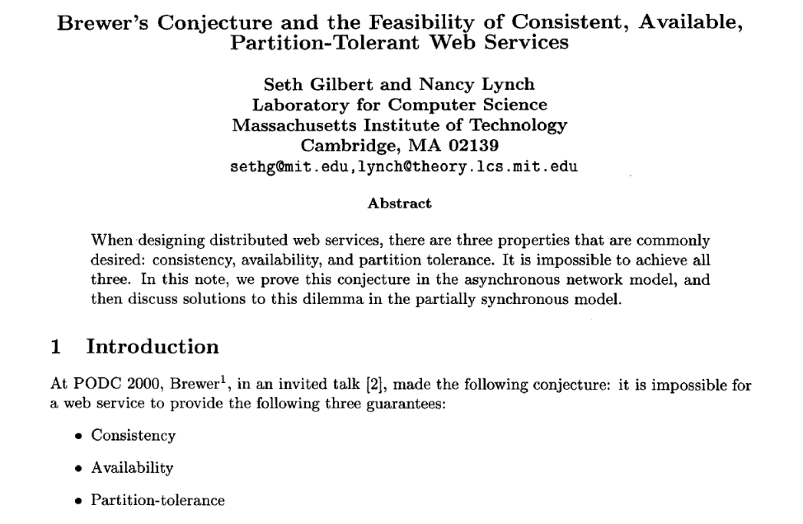
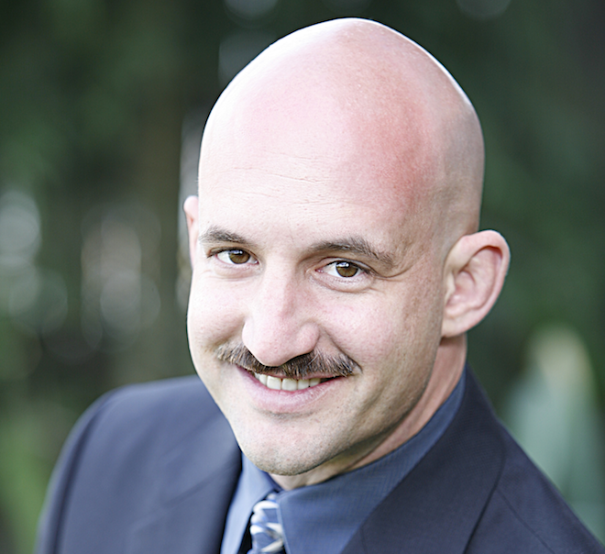
CAP Theorem

Slide 14
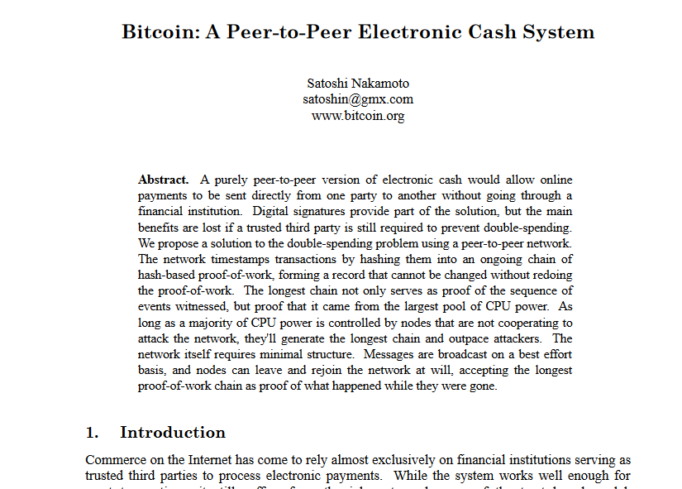

Bitcoin and Blockchain

Slide 15
Bitcoin and Blockchain
Cheats on the CAP theorem
Eventual consistency
Availability
Partition-tolerance (But short)

Slide 16
Proof of Work

Slide 17
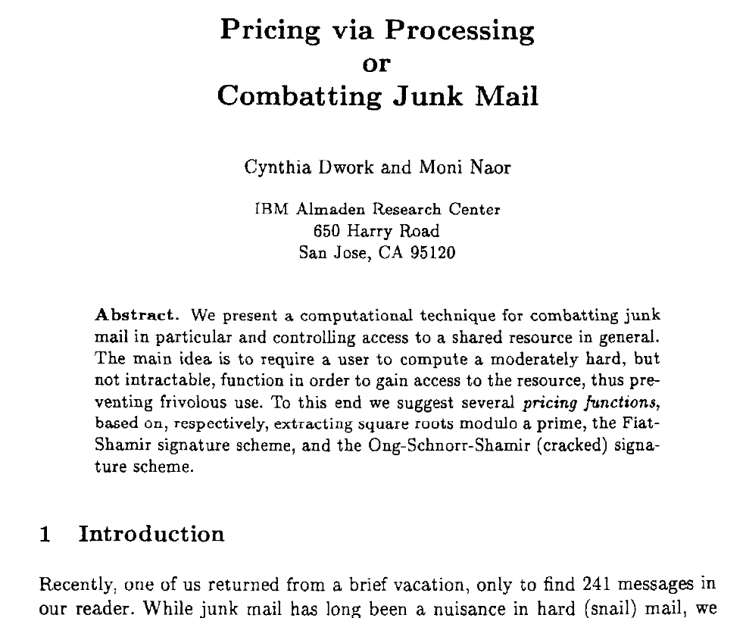
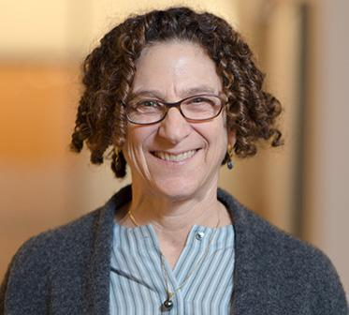
Proof of Work

Slide 18
Proof of Work
y = f(x)
f() este extrem de lentă computațional
x = g(y)
g() este extrem de rapidă computațional

Slide 19

Proof of Work
x; Cât este f(x)?

Slide 20
Proof of Work
Processing!!!

Slide 21
Proof of Work
Processing!!!

Slide 22
Proof of Work
y

Slide 23
Proof of Work
g(y) == x?
DA - știu că a muncit
NU – încearcă să trișeze

Slide 24
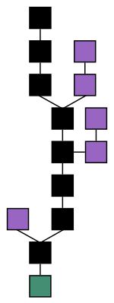
Blockchain

Slide 25
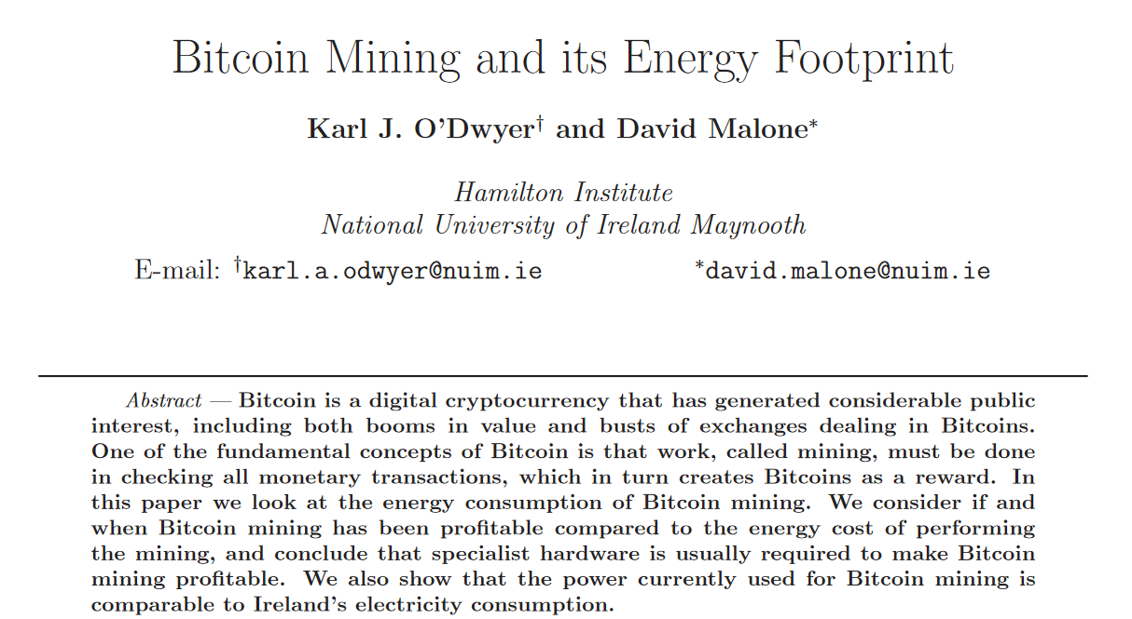
Bitcoin energy consmption

Slide 26
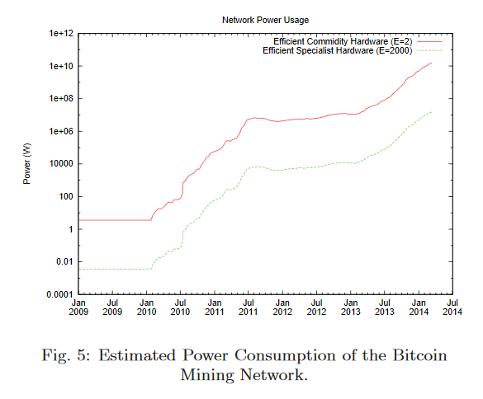
Bitcoin energy consmption

Slide 28
Transactions

Slide 29
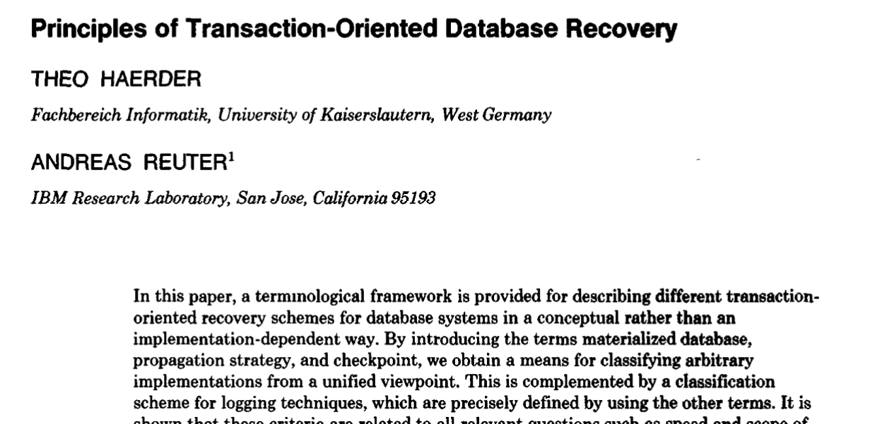


ACID
Notes:
Andreas Reuter
Theo Härder

Slide 30
ACID
Atomicity
Consistency
Isolation
Durability

Slide 32
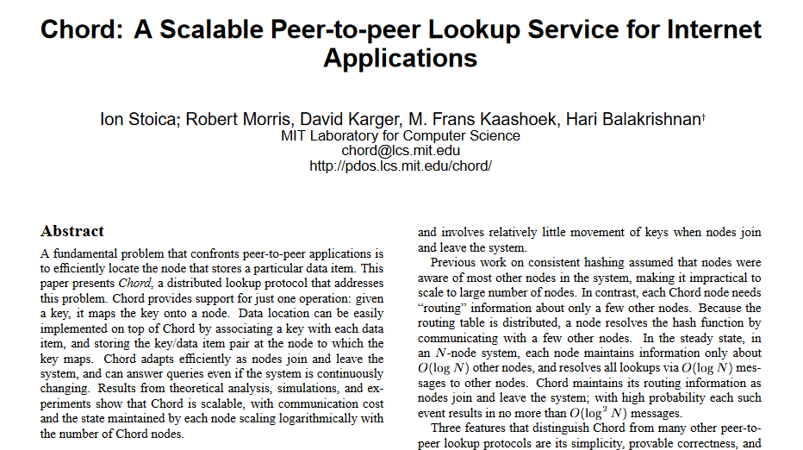
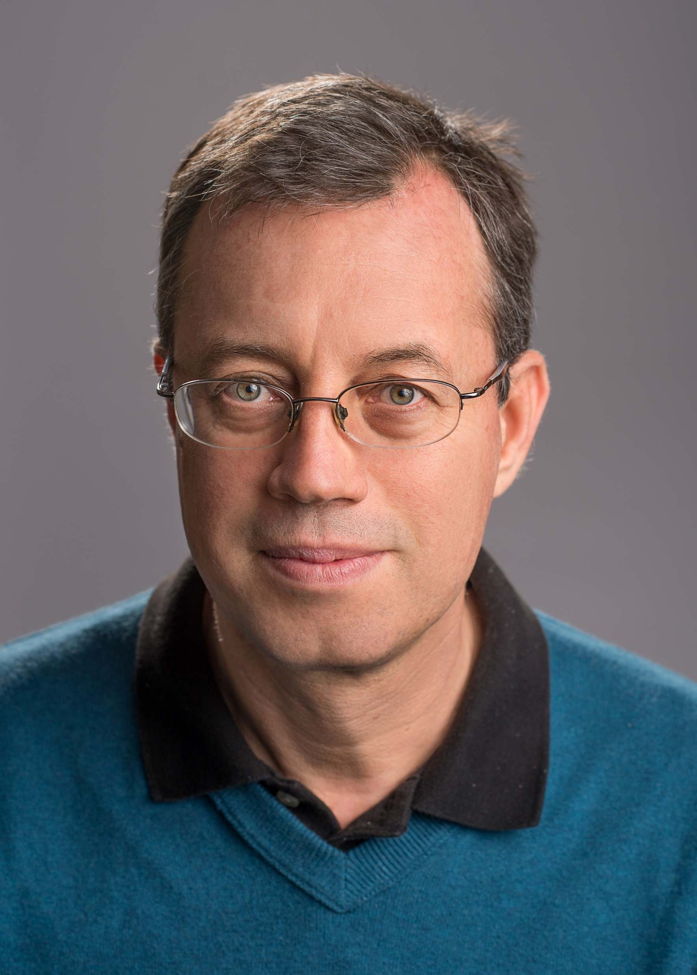
Distributed Hash Table Chord

Slide 33
Amazon DynamoDB

Slide 34
Peer to Peer

